Slide 1
HONEY ENCRYPTION
A SWEET TASTE FOR INTRUDERS
IMPLEMENTATION USING PYTHON 3

Slide 2
SYSTEM REQUIREMENTS
PYTHON 2+ IDE
4+ GB RAM
2.5 + G Hz Clock speed

Slide 3
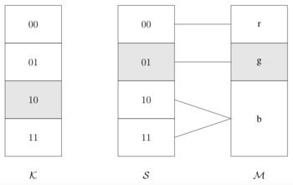
MODULES
Distribution Transforming Encoder

Slide 4

MODULES
HONEY WORDS GENERATOR

Slide 5

HONEY WORDS GENERATION
CHAFFING BY TWEAKING
“Tweak” selected character positions of the password to obtain the honeywords
For each selected position the character of the real password is replaced by a randomly-chosen character of the same type.

Slide 6

HONEYWORD GENERATION
Chaffing-with-a-Password Model
Chooses honeywords from a given list of thousands/millions of passwords
Uses probabilistic model of real passwords
May not depend on user-chosen password
However, attacker might have access to the list of passwords

Slide 7
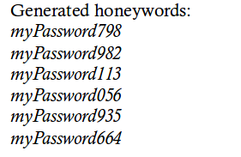
HONEYWORD GENERATION
“take-a-tail” Method
Request password from user and then modify it with a randomized tail

Slide 8

HONEYWORD GENERATION
Hybrid Generation Methods
Combining several methods can result in better
honeywords
Require the user to use digits at the end of the password
Chaffing-with-a-password to generate new random words
Chaffing-by-tweaking-digits on all words

Slide 9
FURTHER IMPLEMENTATION
Main Server and honeychecker server seperation of code.
Upload master password to cloud using binary repository.

Slide 10
REFERENCES
BASE REFERENCE PAPER :Securing cloud data using honey encryption
IMPLEMENTATION MODEL ON CREDIT CARDS
https://www.linkedin.com/pulse/sweet-taste-intruders-honey-encryption-william-buchanan/
Protecting Private Data by Honey Encryption
Wei Yin,1 Jadwiga Indulska,2 and Hongjian Zhou1

